Slide 1
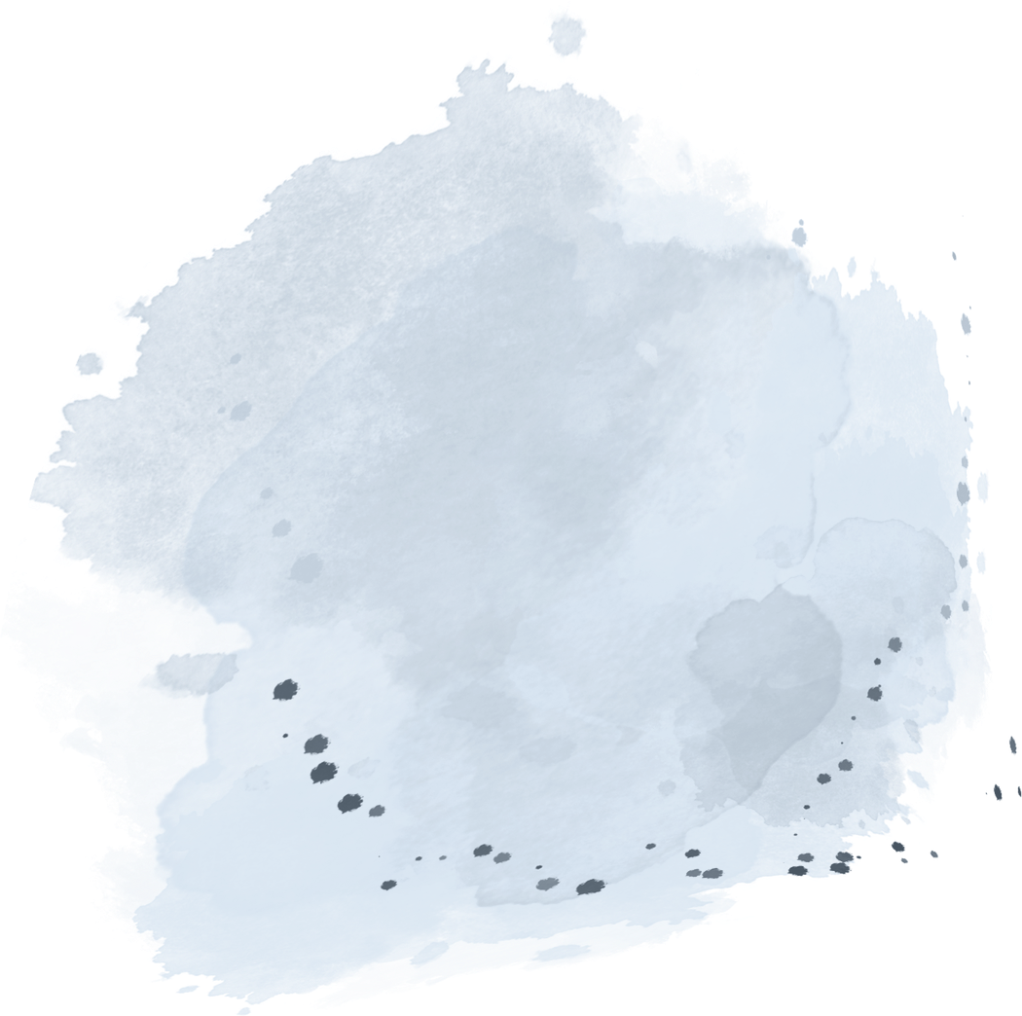



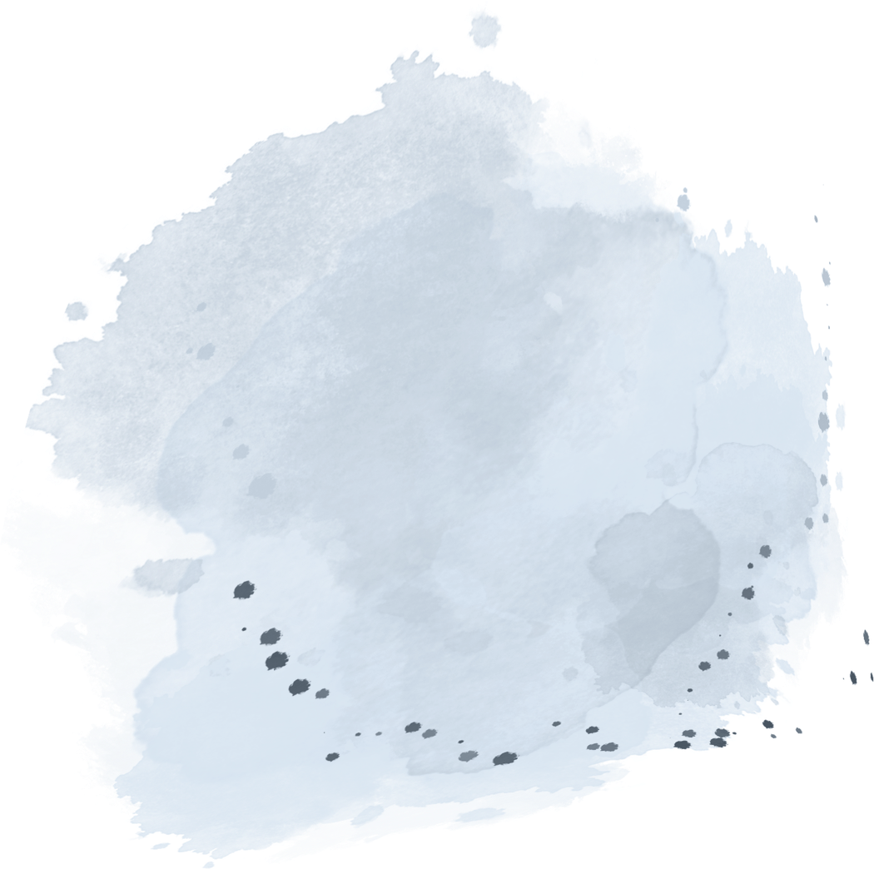





Final Report
The first group
Speecher:张棋瑞、王烨、梁耀欣、朱星徽

Slide 2


1
Introduction
content
2
Method
3
Results
4
Discussion
5
Conclusion

Slide 3

Introduction
Research Background
Further study for the similarities and differernces between Journal and Magazines.
Research Questions
1. What are the style features about citations and sentences of typical articles.
2. What are the structure features about abstract, title and whole article of typical articles.
3. Are there any similarities and differences between them?
4. What do these similarities and differences suggest?

Slide 4


Method
Determine Publications
Journal:The Emergence of Edge Computing
Magazine:Computer vision reveals hidden variables underlying NF-κB activatio-n in single cells.
·Subject
all computer majors
·Authority
Journal: 1270 citations
Magazine: 2,538 times download

Slide 5
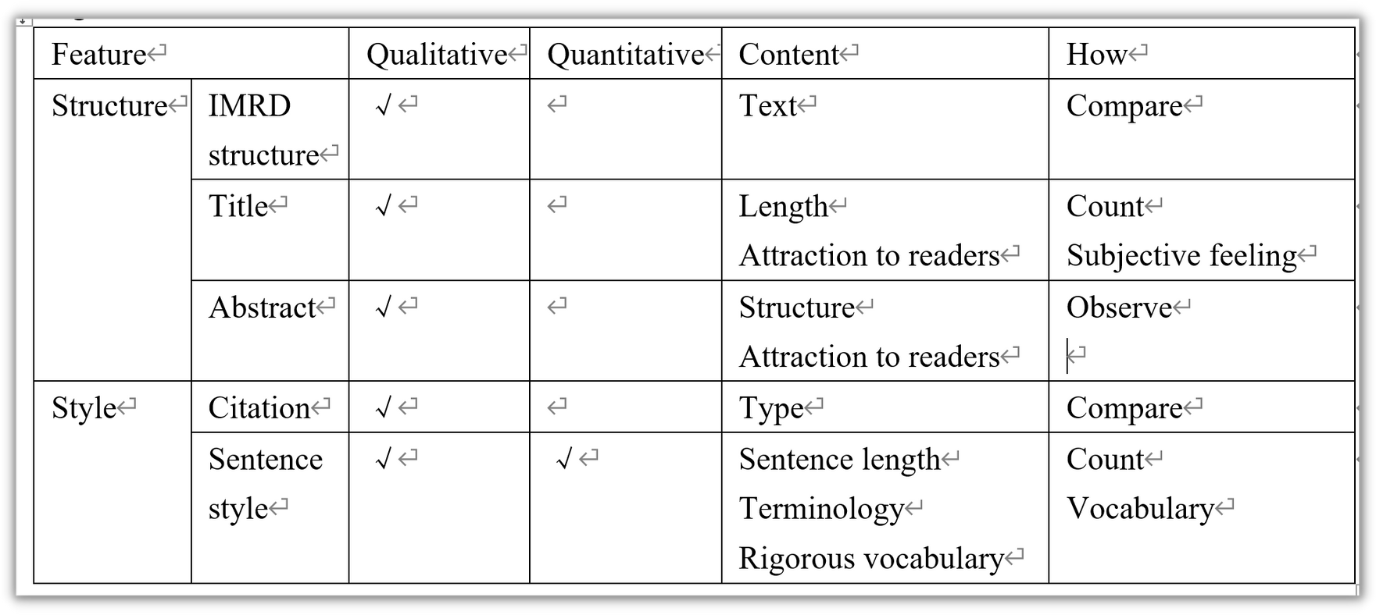
Method
How we carry out the reasrach

Slide 6
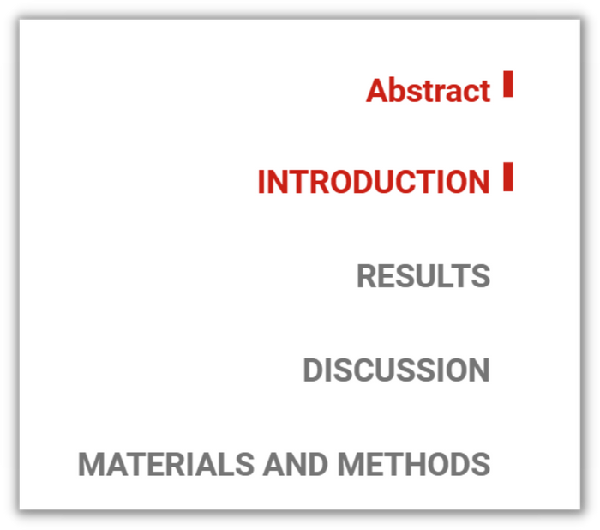


Results
Journal
(Computer vision reveals hidden variables underlying NF-κB activation in single cells）
——structure features
The publication follows the IMRD structure, showing the application of computer science.
Notes:
I will introduce the result part of the structure and style features of journal.First, the publication follows the IMRD structure,includes four parts, Introduction,Results,Discussion and Methods and provides a clear and concise title and abstract.

Slide 7


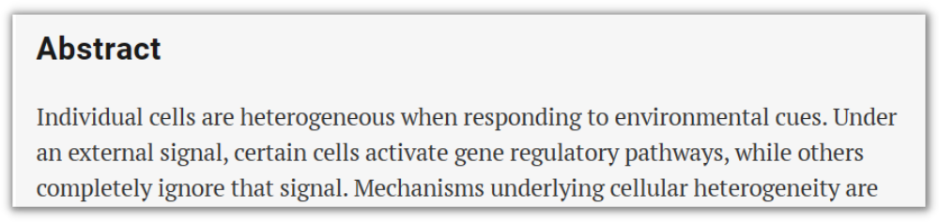
Results
Journal
(Computer vision reveals hidden variables underlying NF-κB activation in single cells）
——structure features
The title and abstract provide a clear and concise summary of the research topic, methodology and findings.

Slide 8


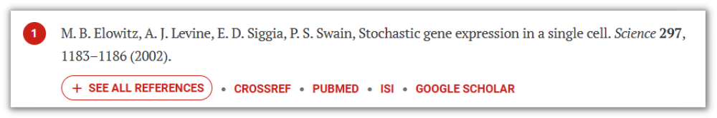

Results
Journal
(Computer vision reveals hidden variables underlying NF-κB activation in single cells）
——style features
The reference is written in the Vancouver citation style.

Slide 9
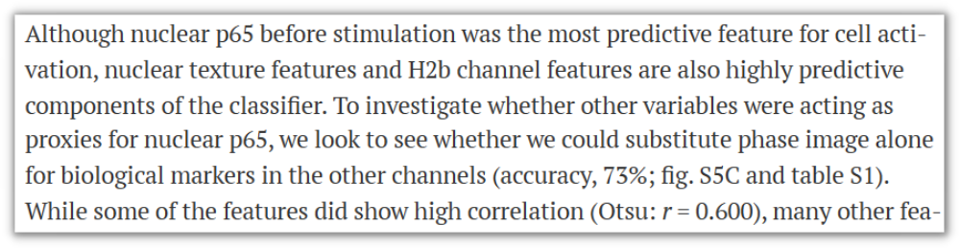

Results
Journal
(Computer vision reveals hidden variables underlying NF-κB activation in single cells）
——style features
This article maintains a moderate sentence length and objective, accurate, and professional language expressions.

Slide 10
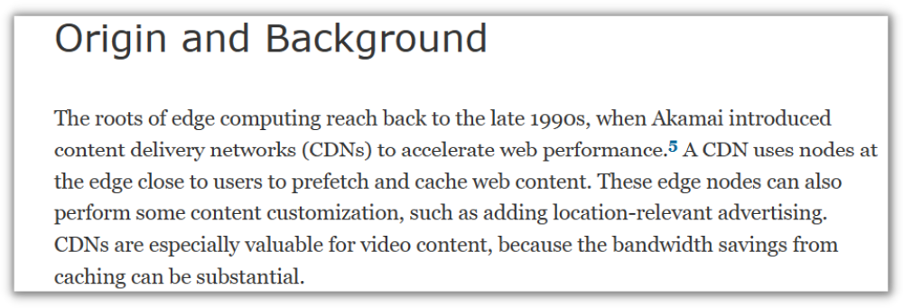
Results
Magazine
(The Emergrnce of Edge Computing）
——structure features
The article dose not follow the IMRD structure.

Slide 11
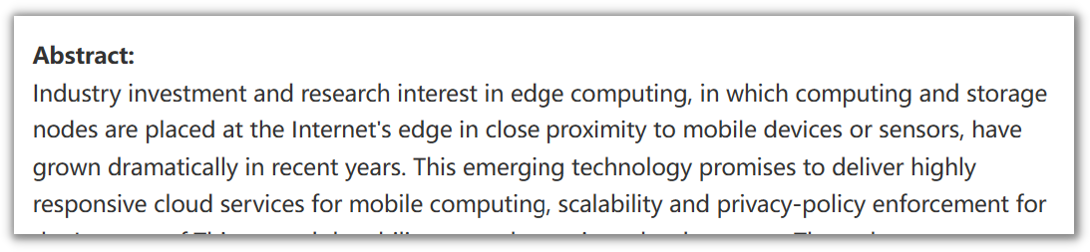
Results
Magazine
(The Emergrnce of Edge Computing）
——structure features
This article's abstract covers the
what,what you found, and so what
sections.

Slide 12
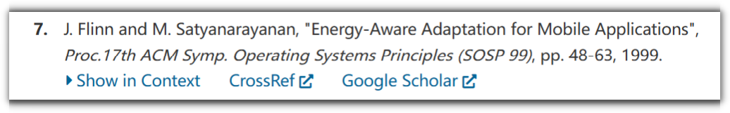
Results
Magazine
(The Emergrnce of Edge Computing）
——style features
The reference is written in the IEEE citation style.

Slide 13
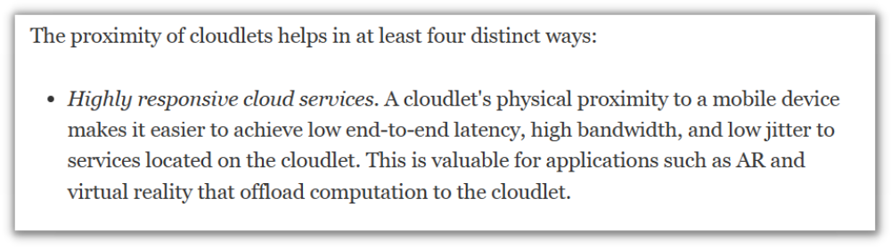
Results
Magazine
(The Emergrnce of Edge Computing）
——style features
This article uses a mix of short and long sentences, along with specialized terminology.

Slide 14

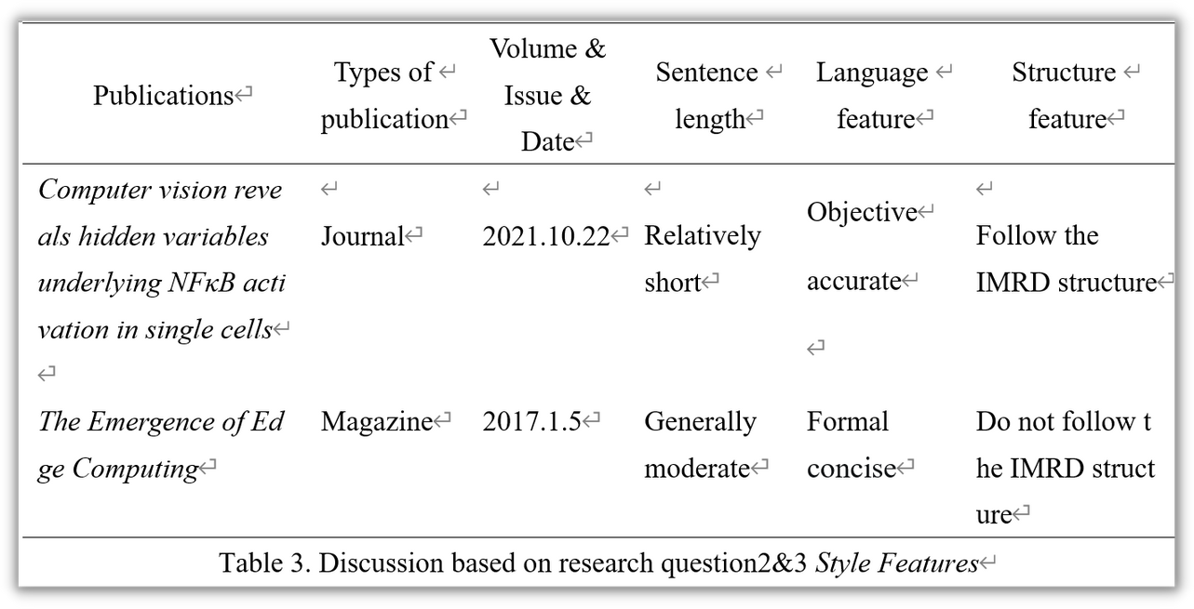


DISCUSSION
1
Style feature
Sentence length
Language feature
2
Structure feature
Similarities
Differences

Slide 15


DISCUSSION
Sentence length
Journal
Magazine
Relatively short
Mostly approaching
20-30 words
Generally moderate
Some longer sentences providing detailed information
Journal
Magazine
Beneficial for readers to grasp the research conclusions, improve the readability of the paper
Help readers to understand more accurate and comprehensive information

Slide 16

DISCUSSION
Language feature
1
2
3
common
journal
magazine
Using a large amount of data and annotations as evidence
Conducive to ensuring the scientificity of research
Presented in the form of charts and figures
More conducive to readers' understanding
Features of technical language and professional terminology

Slide 17
DISCUSSION
Similarities
On the one hand
Emphasize the importance of accurate and attention-grabbing titles and abstracts in academic articles
On the other hand
Highlight how the abstract plays a crucial role in summarizing the main content and facilitating readers' understanding of the core ideas

Slide 18
DISCUSSION
Differences
Journal
Follow the structure of IMRD
Provides a detailed introduction to the purpose, methods, findings, and significance of the research
Magazine
Do not follow the IMRD structure
Focuses more on introducing the potential advantages and applications of edge computing

Slide 19


Conclusion
Research summary
Conclusion
Similarities and differences reveal the structure and style of academic publications.

Slide 20
Thanks for listening
&Further questions

